Slide 1

Mental Therapist for CUHKSZ
Chengxi, Li (120090741)
Ningyuan, Wang (120040061)
Zhuoyi, Li (119010166)
Shiao, Wang (120090241)
Group 13

Slide 2
Agenda
1
Background & Intro
3
Implementation
CONTENTS
2
Demo demonstration
4
Insight & Conclusion
Background & Intro
Demo demonstration
Implementation
Insight & Conclusion

Slide 3
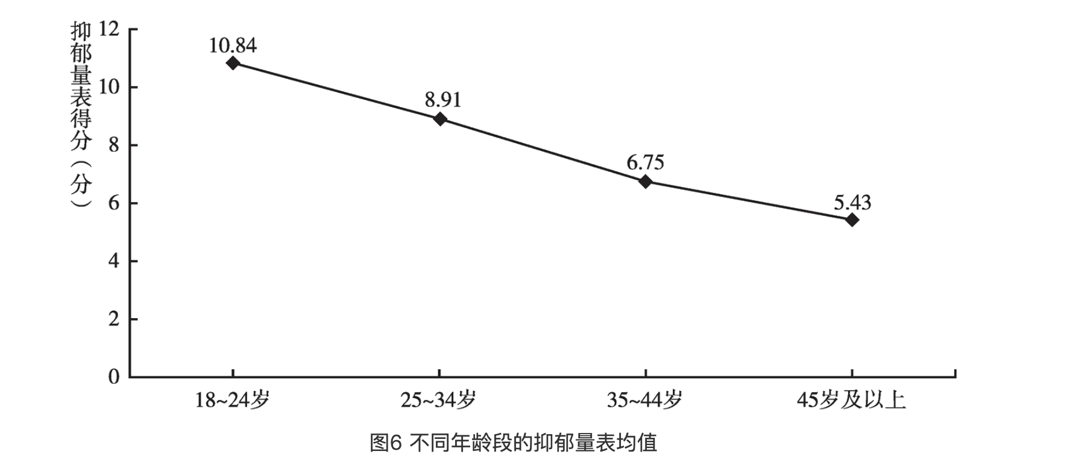
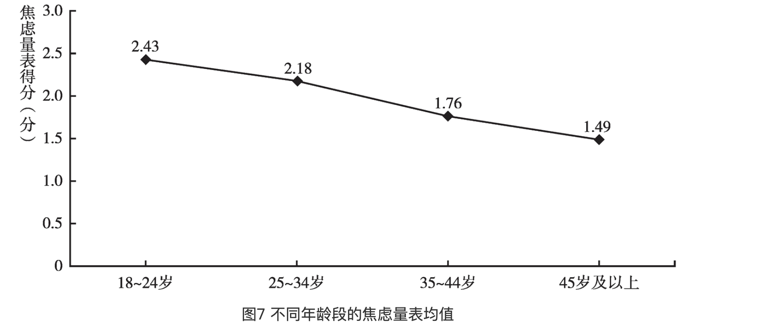
Project Background
Mental Health Situation: 240 million people with mental disorders among China's 1.39 billion population, with a high incidence rate of 17.5%, which continues to increase (2020).
Among them, the psychological health problems of young people are particularly prominent,
With 24.6% of teenagers experiencing depression, and a high proportion of 7.4% experiencing severe depression.
However, usage rate of psychological counseling services for young people with depressive tendencies or high-risk of depression is less than 26%.
Unit：%
The 2020 adolescent sample | Healthy | Mild Dep | Major Dep
Percentage | 75.4 | 17.2 | 7.4
Table 1 Detection rate of depression
Unit：%
Sample of college students in Shenzhen | Consider suicide | Made a suicide plan | Take steps to attempt suicide | Living is meaningless | overpressure
Percentage | 12.1 | 6.6 | 2.2 | 27.5 | 24.4
Table 2 Results of psychological surveys of college students in Shenzhen
Background & Intro
Demo demonstration
Implementation
Insight & Conclusion
Notes:
According to the annual report of the National Health Commission of China and the China National Report on Mental Health Development, as of 2017, there were

Slide 4



CUHKSZ students process for seeking psychological help
CUHKSZ Student
Low campus popularity.
Insufficient evidence for diagnosis and judgment.
Large differences in treatment effectiveness.
Seek psychological help
Route One:
Campus Psychological Counseling Room.
Subjective resistance of students to seek medical treatment.
for diagnosis and judgment. Insufficient evidence
Short consultation and treatment time, direct medication treatment.
High cost, long waiting and treatment cycle.
Academic anxiety
Pressure to enter higher education
Peer anxiety
....
Not Seek psychological help
Route Two:
Psychiatric hospital
AI Therapist
Background & Intro
Demo demonstration
Implementation
Insight & Conclusion

Slide 5
AI Therapist overview
Chat Dialogue
ChatGPT
Therapist
Output
Behave rationally based on up to date AI tech and user input
As a ‘therapist’, take users’ sentiment into higher proportion of account
Function: Provide companion and window to vent on.
Data
Enhancement
Perception of Users
Sentiment Analysis Toolkit
Dialogue info
Users’favor
TTS & Virtual image
Background & Intro
Demo demonstration
Implementation
Insight & Conclusion

Slide 6
AI Therapist Procedure Design
Dialogue Stage
Mental Recovery Stage
Report Stage
User Enter
Score evaluation
Generate Report
会谈法
观察法
诊疗工具：量表等
心理问题诊断的六大程序
Conversation
Provide recovery tips and suggestions
Provide indication of user’s mental situation
Provide professional source and guidance for mental help
既往史调查
General Information
Physical State Social Interpersonal Relationships
Negative Confront
Calming Practice
Offering companion and window to vent on
Further Dialogue
Sentiment Analysis
Extreme Behavior analysis
Professional recovery procedure
Emotion score
Extreme behavior score
心理咨询的一般流程图
Background & Intro
Demo demonstration
Implementation
Insight & Conclusion

Slide 7
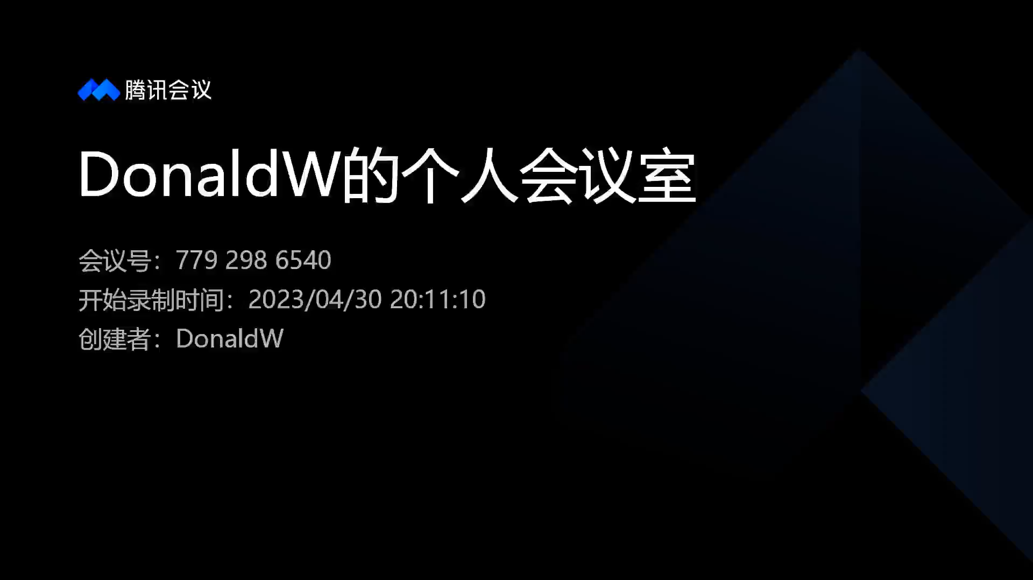
Demo Demonstration
Background & Intro
Demo demonstration
Implementation
Insight & Conclusion

Slide 8
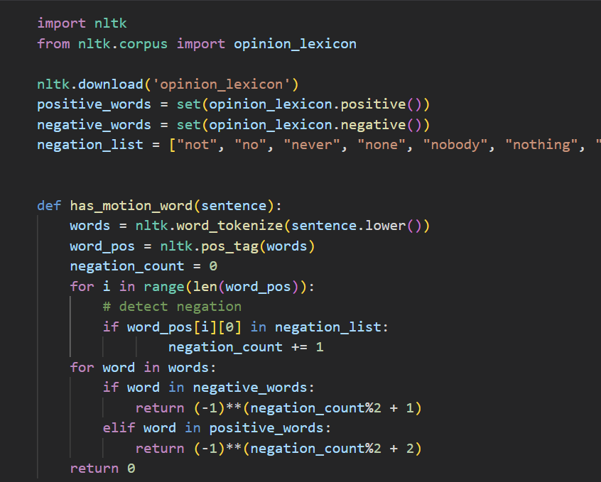
Implementation | Sentiment Analysis
Sentiment keyword detection
Keyword Detector
Emotional keyword
Extreme Behavior
Keyword
"happy", "sad", "depressed", "heart-broken", "joyful", "pleased", "delight", "somber", "downcast", "grieving"
‘suicide‘ ‘murder“self-destruction’self-murder” "assassination” ,"homicide", "hari-kari", "killing", "slaying",
"manslaughter"
Core Code
Background & Intro
Demo demonstration
Implementation
Insight & Conclusion

Slide 9
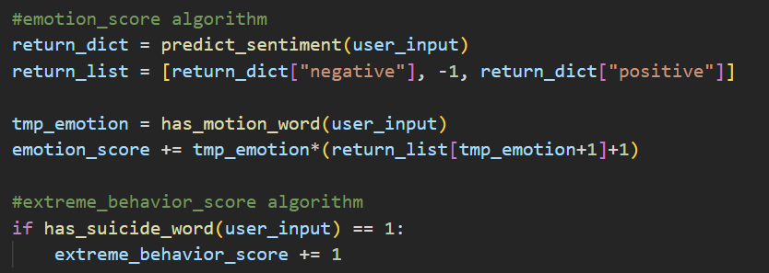
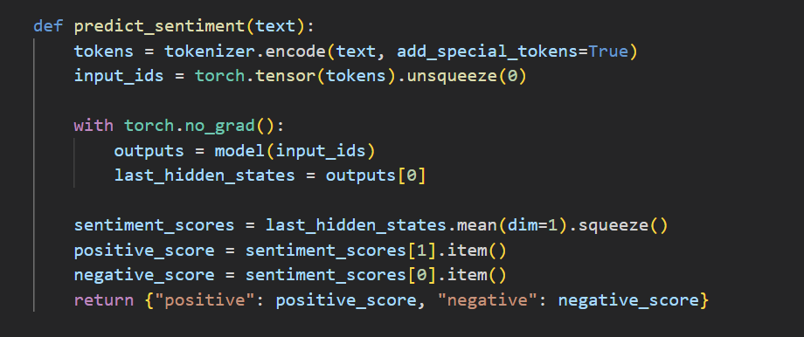
Implementation | Sentiment Analysis
Keyword Detector
Pretrained model:
ChatGPT (based on transformer)
Scoring Algorithm
Scoring base on context
Emotion score
Extreme behavior score
Core Code
Background & Intro
Demo demonstration
Implementation
Insight & Conclusion

Slide 10
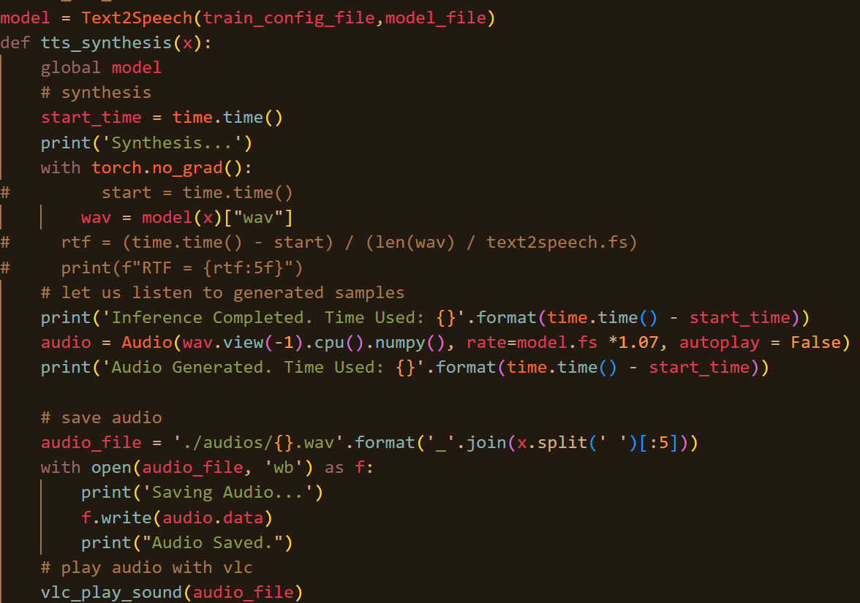



Implementation | TTS & Virtual image
TTS toolkit: kan-bayashi_ljspeech_vits
Virtual image toolkit: Vtube Studio
Chat Dialogue
Generated Response
Scoring
User Preference
TTS & Virtual image
Core Code
Background & Intro
Demo demonstration
Implementation
Insight & Conclusion

Slide 11
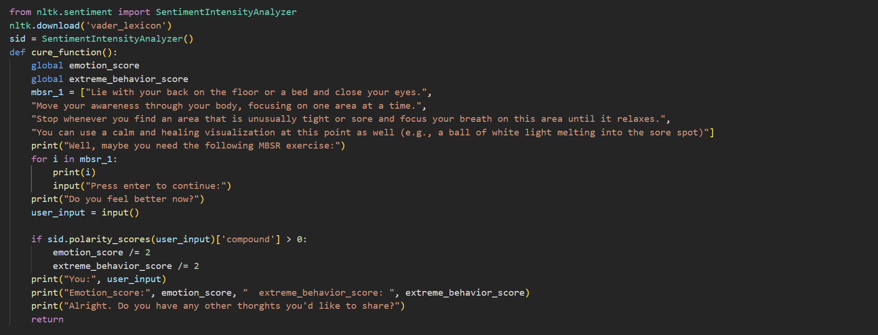
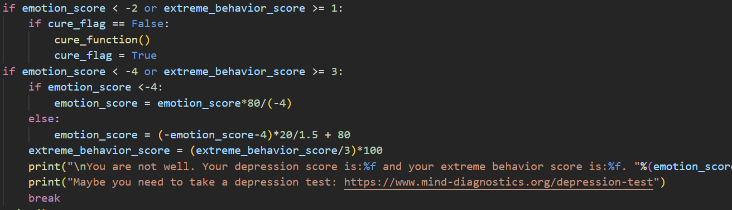
Implementation | Recovery Guidance and Report
-4 Point
Report Generation:
Triggered when the point is lower the negative 4
Generate two indicator, Emotional score and Risk Score based on the dialogue and scoring.
Provide professional mental self test link
Provide indicator to campus clinic to show students mental situation without privacy issue
-2 Point
Procedural Recovery Guidance:
Triggered when the point is lower the negative 2
Adopt professional recovery procedure, including mindfulness training, MBSR exercise…
Core Code
Emotion scoring
Background & Intro
Demo demonstration
Implementation
Insight & Conclusion

Slide 12
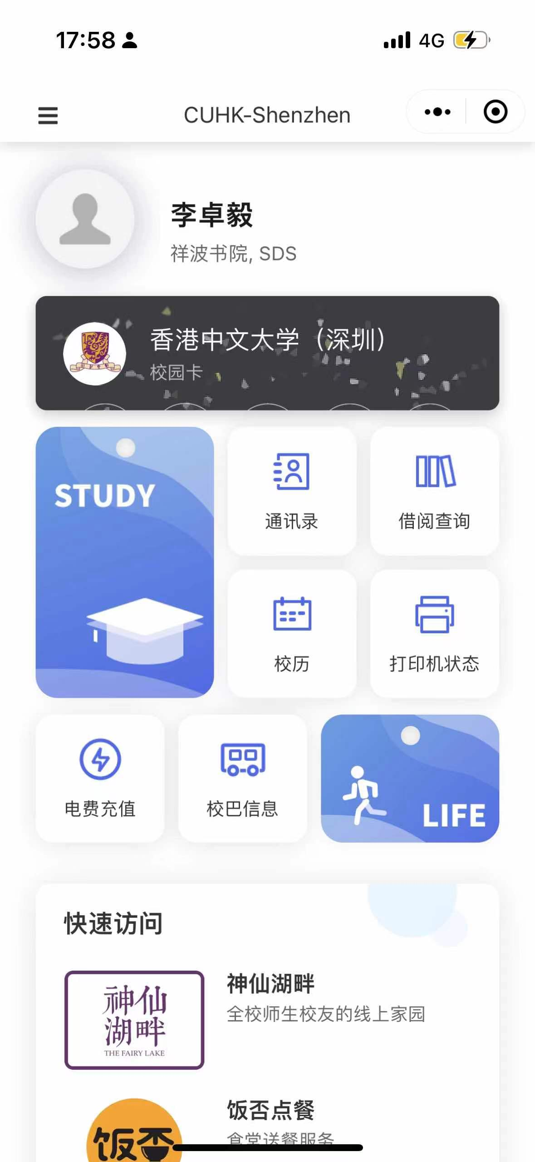

Conclusion & Insight
Application scenarios:
Embedded into Wechat applet that CUHKSZ students frequently used
Developed together with inquiry robot located in campus clinic
Work together with Campus Psychological Counseling Room, provide companion when the assistance is not available
Behave rationally & considerably
Work with professional people
Lots of work to upgrade
Make users happy!
Creativity:
the app takes into account the user's mood, preferences, and feelings to provide customized advice and suggestions. (Research gap)
Forerunner to combine AI and mental therapy. Provide insight.
Practicality:
Functionally worked!
User feedback experiment has been running, elaborated in report
Background & Intro
Demo demonstration
Implementation
Insight & Conclusion

